Slide 1
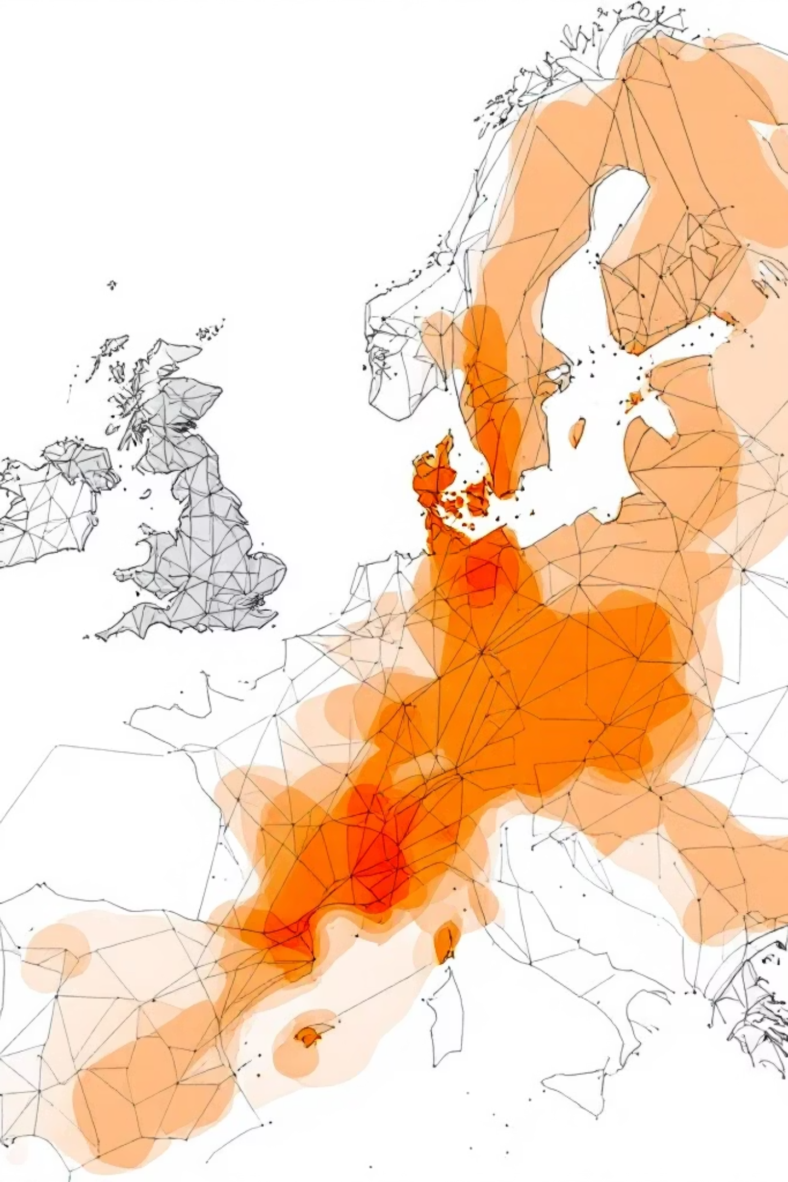
Optimising Uber Operations Through Data Analytics
Transforming ride-sharing efficiency through strategic data analysis and operational intelligence

Slide 2
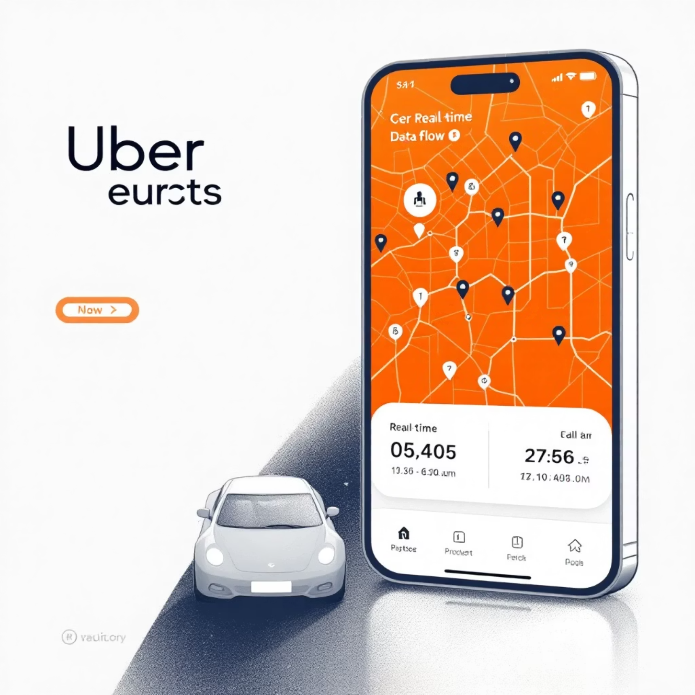
The Data-Driven Revolution in Transport
Uber processes over 15 billion trips annually, generating massive datasets that power operational decisions. This data ecosystem enables real-time optimisation across global markets.
Every ride creates multiple data points: pickup locations, wait times, route efficiency, driver availability, and demand patterns. These insights drive strategic improvements.

Slide 3

Core Analytics Challenges
Demand Forecasting
Supply Optimization
Dynamic Pricing
Predicting peak demand periods across different geographical zones and times
Ensuring adequate driver availability in high-demand areas
Balancing rider affordability with driver incentives through surge pricing

Slide 4



Data Sources Powering Decisions
Location Intelligence
Temporal Analytics
External Factors
Real-time GPS data from millions of devices provides granular insights into traffic patterns, popular destinations, and optimal routing.
Historical booking data reveals peak demand windows, seasonal trends, and event-driven surge patterns across different market segments.
Weather conditions, public events, and local transportation disruptions are integrated to predict demand fluctuations and supply requirements.

Slide 5



Machine Learning in Action
Data Ingestion
Pattern Recognition
Automated Response
Real-time streaming of trip requests, driver locations, and market conditions
ML algorithms identify demand patterns and predict supply-demand imbalances
Dynamic pricing adjustments and driver incentive programmes activated automatically

Slide 6
Key Performance Metrics
4.2
23%
18%
Average Wait Time
Efficiency Improvement
Revenue Growth
Minutes reduced through predictive driver positioning algorithms
Increase in successful booking completion rates during peak periods
Annual increase attributed to optimised pricing and supply management

Slide 7
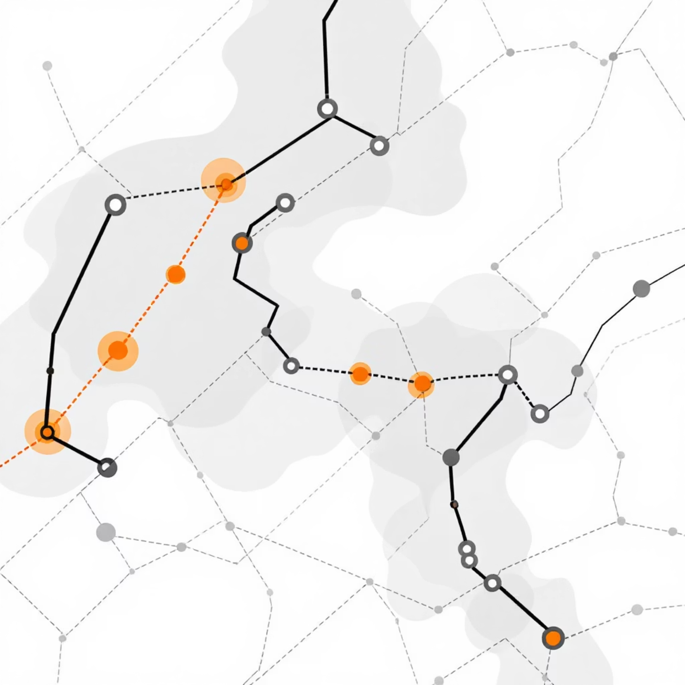
Surge Pricing Analytics
Dynamic Pricing Algorithm
Uber's surge pricing system analyses real-time supply-demand ratios to automatically adjust fares. This data-driven approach:
Incentivises more drivers during peak demand
Reduces passenger wait times by 35%
Maintains service availability in high-demand areas

Slide 8
Geographic Optimisation Strategies
Heat Map Analysis
1
Identifying high-demand zones through historical booking data and real-time requests
2
Driver Positioning
Predictive algorithms guide drivers to optimal locations before demand peaks occur
Route Optimisation
3
AI-powered routing reduces journey times by 15% whilst minimising fuel consumption

Slide 9
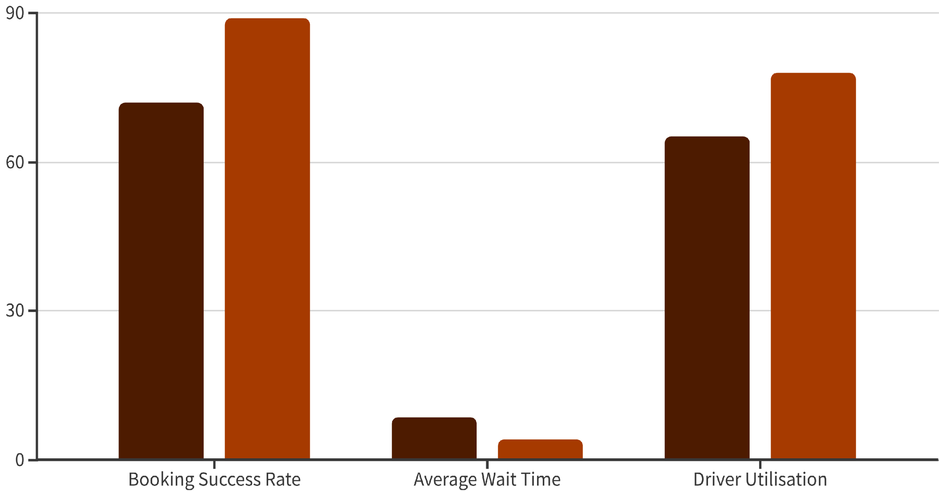
Operational Impact Assessment
Before Analytics
After Implementation
Data analytics implementation demonstrates measurable improvements across all key operational metrics, validating the strategic investment in analytical capabilities.

Slide 10
Strategic Takeaways
Data-Driven Excellence
Real-Time Responsiveness
Continuous analytics investment enables operational optimisation and competitive advantage in dynamic markets
Machine learning algorithms provide immediate operational adjustments, enhancing service quality and efficiency
Data analytics transforms operational challenges into strategic opportunities for sustainable growth

